Slide 1
THIS SLIDE IS TO BE REMOVED AFTER READING
This slide deck was created by VA’s Suicide Prevention Program and is designed to be used by Governor’s and Mayor’s Challenge Teams when presenting to communities, partners, stakeholders, and other audiences.
Feel free to delete or add slides as needed based on the length and topic of your presentation. We have included more slides to provide as much detail as possible, but most presentations will likely only have time to cover a few.
Topics covered include:
  Governor’s and Mayor’s Challenges Overview
  Editable Slides for Challenge Teams
  Public Health Approach
  Discussion/Conclusion

Slide 2

Team Name
Title Name
Location
Date

Slide 3
Governor’s and Mayor’s Challenge to Prevent Suicide Among Service Members, Veterans, and their Families

Slide 4
About the Challenge
States and communities have been partnering with VA and Substance Abuse and Mental Health Services Administration (SAMHSA) on the Mayor’s and Governor’s Challenge since 2019.
Mayor’s and Governor’s Challenge teams develop plans to implement the National Strategy for Preventing Veteran Suicide, which provides a framework for identifying priorities, organizing efforts, and contributing to a national focus on Veteran suicide prevention.
Teams work to identify their top priorities, best strategies for their community’s needs, and efforts they will use to evaluate their outcomes.
  Not one plan will fit every community, so strategies vary across communities.
This work is critically important because local leaders know their populations best.

Slide 5
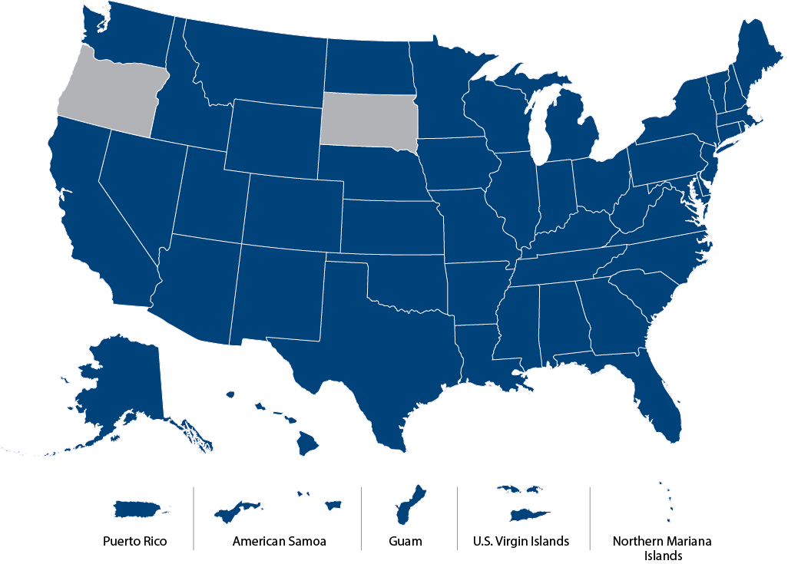

Partnering Across the Nation
Goal: Develop state and local plans based on the public health approach to prevent suicide.
Governor’s and Mayor’s Challenge teams include collaborative groups of community, municipal, military, Veteran, and other stakeholders.
VA/SAMHSA provide technical assistance to support local efforts, document outcomes, and share strategies with other municipalities.
The Governor’s Challenge took the Mayor’s Challenge to the state level, incorporating existing community strategic plans within their respective states.
5

Slide 6
Community-Based Interventions
Community-Based Interventions for Suicide Prevention (CBI-SP) serves as unifying model, from national to community levels, for all community-based efforts to end Veteran suicide.
The Governor’s Challenge is a collaboration with VA and SAMHSA where state policy makers partner with local leaders to implement a comprehensive suicide prevention plan.
Together with Veterans is focused on Veteran-to-Veteran coalition building and Veteran leadership development for suicide prevention.
Community Engagement and Partnerships for Suicide Prevention is focused on facilitating community coalition building for suicide prevention.
Outreach and Education provides VA SAVE, VHA facility partnerships, events, etc. through local Suicide Prevention Coordinators (SPCs) and does not change their critical role.
National Level
National VA Suicide Prevention Program
State Level
Governor’s Challenge
Community Engagement and Partnerships for Suicide
Prevention
Community
Level
Together With Veterans
Outreach and Education
6
Notes:
The Governor’s/Mayor’s Challenge is part of the overarching effort around VA’s Community-Based Interventions for Suicide Prevention, which serves as a unifying model that aims to reach Veterans through multiple touchpoints – from national to community levels, for all community-based efforts to end Veteran suicide.

Slide 7



Priority Areas of Focus
Identify service members, Veterans, and their families and screen for suicide risk
Promote connectedness and improve care transitions
Increase lethal means safety and safety planning
7

Slide 8
[State/Community] [Governor’s/Mayor’s] Challenge
Our Action Plan Highlights:
  Below are examples. Replace with your team’s efforts:
    Identify service members, Veterans, and their families: Implement Ask the Question (“Have you or a loved one ever served in the military?”) by adding screening question across all government agency intake forms.
    Promote connectedness: Develop state-wide peer support program for Veterans and family members.
    Increase lethal means safety: Establish “lock and talk” partnerships with local gun shops to promote suicide prevention resources.
Insert Logo/Photo Here if Desired
8

Slide 9
Team Composition
If relevant for the presentation, consider adding organizations that comprise your Mayor’s/Governor’s Challenge team. Below are examples. Replace with your team’s info:
Our team is comprised of representatives from:
[Governor’s/Mayor’s] Office
[Location] Department of Veterans Affairs
[Location] Department of Health
[Location] Department of Human Services
[Location] VA Medical Center
[State] National Guard
University of [Location]
AMVETS
American Legion
National Alliance of Mental Illness
Mental Health America
Etc.
9

Slide 10
Program Highlight
If relevant for the presentation, consider sharing details about one or more of the planned strategies from your team’s Action Plan. Below are examples. Replace with your team’s efforts:
The [state/community] [Governor’s/Mayor’s] Challenge team plans to develop a gun lock distribution pilot program, with a planned launch in January 2023.
Components of the pilot include distribution of gun locks and increasing messaging about lethal means safety, specifically towards clinicians.
Outcome measures for the pilot include:
  # of gun locks distributed over 6 months
  % increase in clinicians who offer gun locks to patients pre- and post- implementation of the pilot (6-month timeframe)
10
Notes:
Consider the following framework for outlining your program:
Brief description of program/pilot, including expected timeframe of launch
Additional relevant details about program/pilot
Any process/outcome measures

Slide 11
Next Steps
Describe the next steps to take toward accomplishing the goals in your action plan, or highlight any upcoming events—examples below:
Next steps for our pilot program involve development of messaging for clinicians around lethal means safety.
  We plan to conduct interviews with clinicians to understand clinician perspectives around gun locks and lethal means safety.
  We are currently seeking 5-6 more clinicians for interviews – email [team member] if you are interested in participating!
Our team is also co-hosting a Suicide Prevention Awareness event with [agency] on September 16, 2022. Go to [website] to register for the event!
The team continues to meet monthly and will be providing a briefing to the [Governor’s/Mayor’s] Office in October.
11
Notes:
Consider including a Call To Action to your audience.

Slide 12
Lessons Learned Through Our Challenge So Far
Edit the examples below or add your own examples of lessons learned
After identifying service members, Veterans, and family members, it is important to have suicide risk screening and a referral process for indicated needs.
Care coordination can assist with lethal means safety efforts, like doing gun lock distribution throughout a care coordination network.
Safety planning can help Veterans stay safe during a crisis and during care transitions.
Be creative and flexible to match the needs of the community.
Collaboration with a broad range of organizations and utilizing existing programs and resources has been key to our success.
12

Slide 13
The Public Health Approach
VA takes a public health approach to preventing Veteran suicide. The next three slides are meant to provide background about this approach to inform your team’s strategy.

Slide 14
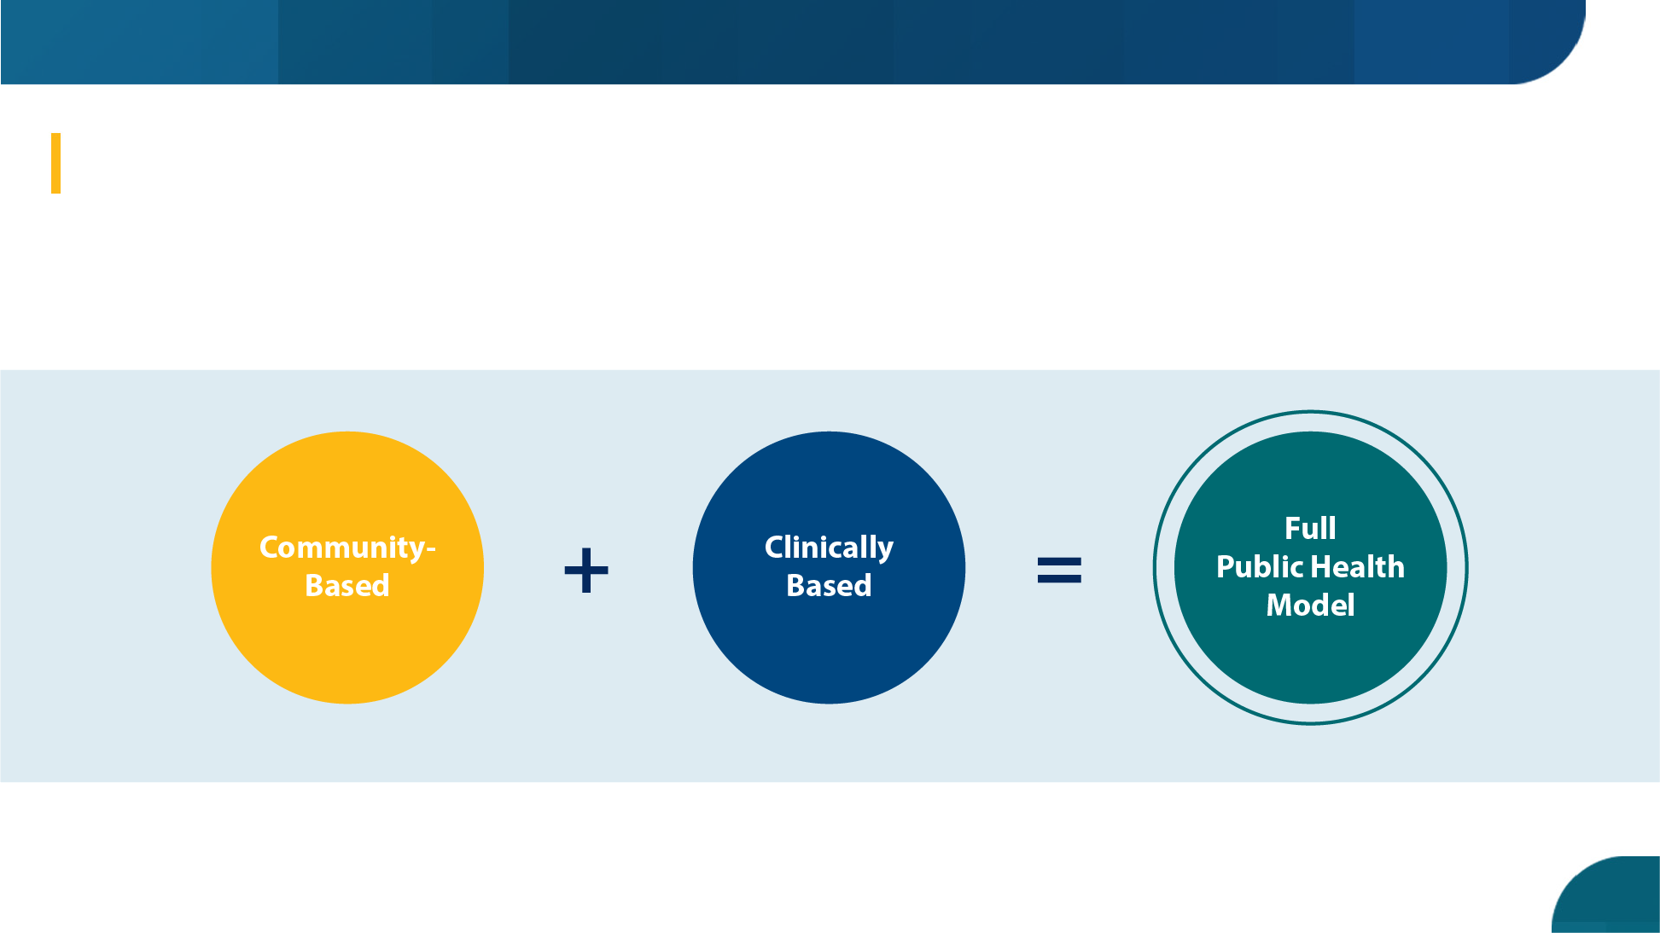
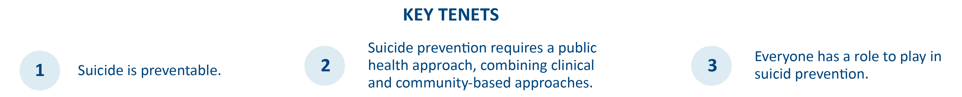
VA’s Public Health Strategy
VA's public health strategy combines partnerships with communities to implement tailored, local prevention plans while also focusing on evidence-based clinical strategies for intervention. Our approach focuses on both what we can do now, in the short term, and over the long term, to implement VA’s National Strategy for Preventing Veteran Suicide.
14

Slide 15

Suicide Prevention 2.0 Vision for the Distance:
Combining Community & Clinical Interventions
Community-Based Prevention Strategies
Clinically Based Interventions
Veterans Integrated Service Networks (VISN)-Wide Community Prevention (Community Coalition Building)
Together With Veterans (Veteran-to-Veteran Building)
Governor’s/Mayor’s Challenge (State-Driven Suicide Prevention Planning)
Evidence-Based Psychotherapies Implemented Across the Nation (including Cognitive Behavior Therapy for Suicide Prevention, Dialectical Behavior Therapy, and Problem-Solving Therapy)
Community
Engagement
and Partnership
Coordinators
(CEPCs)
Foundation of Adequate Mental Health Staffing
(7.72 outpatient mental health full-time equivalent employees/1,000 Veterans in outpatient mental health)
15

Slide 16
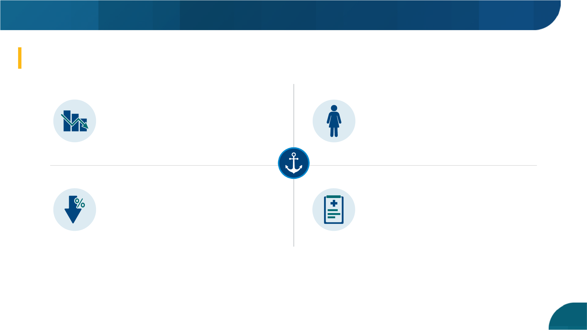
Anchors of Hope
In 2019, there was an almost 13% one-year rate decrease for women Veterans, which was the largest rate decrease for women Veterans in 17 years.
399 fewer Veterans died from suicide in 2019 than in 2018, reflecting the lowest count of Veteran suicides since 2007.
The single-year decrease of 7% for 2019 was larger than any observed decrease from 2001 through 2018 and was a more-than-four-times-greater decrease than for the non-Veteran population.
So far, there does not appear to be an increase in Veteran suicides related to COVID-19, but the data continues to be gathered and will be reviewed.
And yet, we need to do more. We cannot do this work without each of you.
16

Slide 17
Join Us in Action
Suicide is a complex issue with no single cause. We all have a role to play in reducing Veteran suicide.
We prevent suicide through meaningful connection, one person at a time. Here’s what you can do to help prevent Veteran suicide:
  Become knowledgeable about suicide data and suicide prevention resources.​ All resources can be downloaded at: https://www.mentalhealth.va.gov/suicide_prevention/data.asp.​​
  Promote VA S.A.V.E. Training to your community: https://psycharmor.org/courses/s-a-v-e/. ​
  Help create a safe community for Veterans by posting the Veterans Crisis Line number
  (Dial 988 then Press 1) around your organization’s offices and in office newsletters.​
We want all Veterans and community partners to know that help is always available.
17

Slide 18
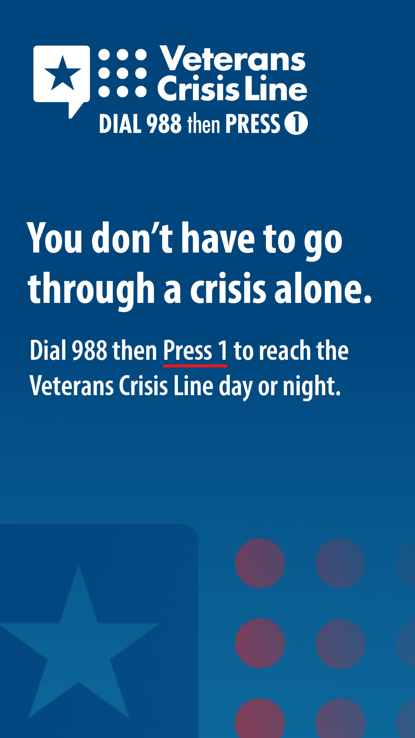
Share the Veterans Crisis Line with your Networks
The Veterans Crisis Line has a new, easy-to-remember number: Dial 988 then Press 1.
Help spread the word by visiting VeteransCrisisLine.net to find downloadable assets.
Here are a few simple actions you can take:
  Update your websites and digital assets with the new logo
  Share on social media using sample posts and graphics for use on Facebook, Twitter, and Instagram
  Use a Dial 988 then Press 1 email signature image and video conference background
  Share the pre-written newsletter, blog, and email content with your networks
As mentioned in the notes section, copy and paste link to the Veterans Crisis Line PSA (library found here) that you would like to show your audience. The PSA can be played from this slide.
18
Notes:
Feel free to share a PSA during your presentation. Various PSAs can be found at the Veterans Crisis Line Spread the Word page (link in slide).

Slide 19
Discussion
Notes:
Question examples:
Where are you playing a role?
What can we do, together, to build and keep the momentum going against suicide?
What challenges have you had in advancing suicide prevention best practices within your company/organization/community?
How can your organization and [insert team name] increase collaboration?

Slide 20



Stay Connected
Follow us on social media.
@U.S. Department of Veterans Affairs
@DeptVetAffairs
@DeptVetAffairs
Add link to Instagram page
Add link to Facebook page
Add link to Twitter page
20

Slide 21

[Insert Contact Email or Team Website]
[Insert image of your logo]
21

